Slide 1
Dimension Reduction for Big Data
25th June 2018
Devin Nanayakkara

Slide 2
Overview
Dimension Reduction for Big Data
25th June 2018
Introduction
Motivation
Goal
Implementation
Results
Conclusion

Slide 3








Applications
Dimension Reduction for Big Data
25th June 2018
Analytics
Business Intelligence
Infrastructure

Slide 4
Curse of Dimensionality
Dimension Reduction for Big Data
25th June 2018
Data isolation
Notes:
As dimensionality increases, the volume of the space also increases.
More and more samples are required to perform machine learning or statistical analysis.

Slide 5
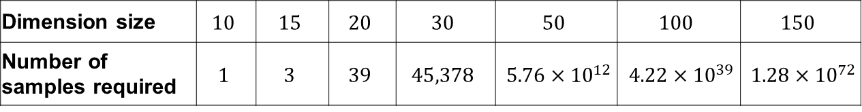
Curse of Dimensionality
Dimension Reduction for Big Data
25th June 2018
Data isolation
Number of training samples required for a K-Nearest Neighbour search algorithm
Dimension size | $$10$$ | $$15$$ | $$20$$ | $$30$$ | $$50$$ | $$100$$ | $$150$$
Number of samples required | $$1$$ | $$3$$ | $$39$$ | $$45,378$$ | $5.76×{10}^{12}$ | $4.22×{10}^{39}$ | $1.28×{10}^{72}$

Slide 6
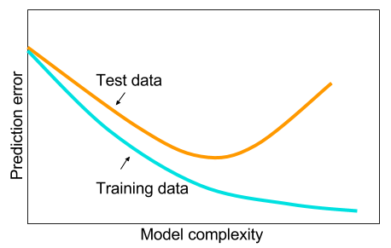
Curse of Dimensionality
Dimension Reduction for Big Data
25th June 2018
Data isolation
Overfitting
Notes:
The complexity of the data increases with the dimensionality.
In a neural networks application, the hidden layers will be very complex.
This leads to…..

Slide 7
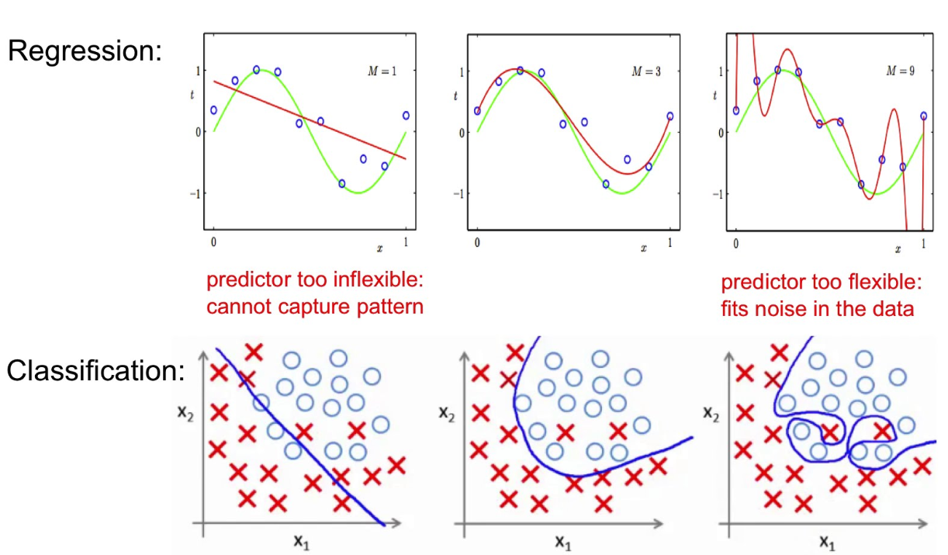
Curse of Dimensionality
Dimension Reduction for Big Data
25th June 2018
Data isolation
Overfitting
False Structure

Slide 8
Curse of Dimensionality
Dimension Reduction for Big Data
25th June 2018
Data isolation
Overfitting
False Structure
Computation difficulty
Time
Complexity
Notes:
A simpler, but sometimes very effective,
way of dealing with high-dimensional data is to reduce the number of dimensions

Slide 9
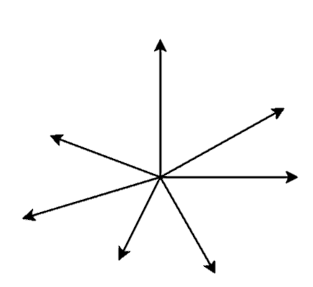
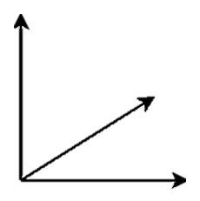



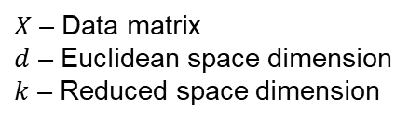


Random Projection (1)
Dimension Reduction for Big Data
25th June 2018
$$Φ$$
$$d>k$$
$X$ in $ℝ^{d}$
$Φ(X)$ in $ℝ^{k}$
Assist applications whose data is represented geometrically in high dimensional vector spaces
$X$ – Data matrix
$d$ – Euclidean space dimension
$k$ – Reduced space dimension

Slide 10
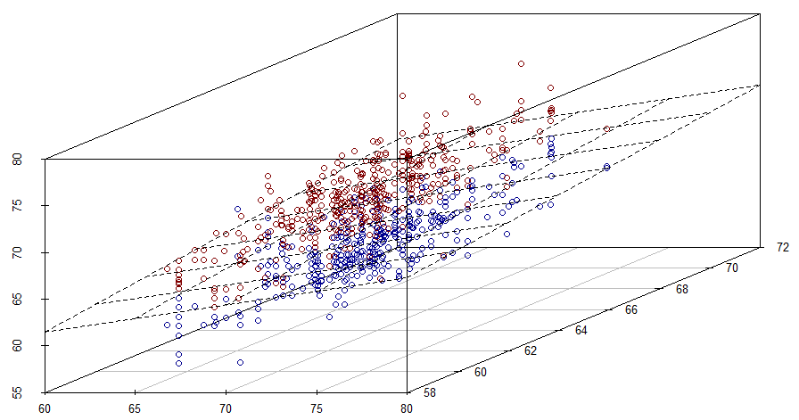
Random Projection (2)
Dimension Reduction for Big Data
25th June 2018

Slide 11
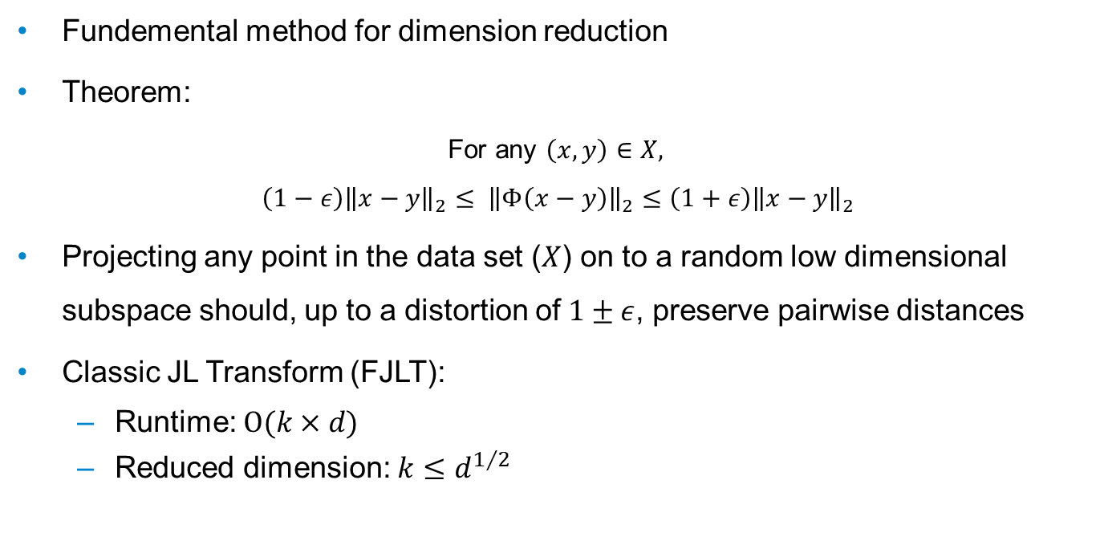
Johnson-Lindenstrauss Transform
Dimension Reduction for Big Data
25th June 2018
Fundemental method for dimension reduction
Theorem:
For any $\left(x,y\right)∈X,$
$$\left(1−ε\right){\left\|x−y\right\|}_{2}≤ {\left\|Φ\left(x−y\right)\right\|}_{2}≤\left(1+ε\right){\left\|x−y\right\|}_{2}$$
Projecting any point in the data set ($X$) on to a random low dimensional subspace should, up to a distortion of $1±ε$, preserve pairwise distances
Classic JL Transform (FJLT):
Runtime: $O(k×d)$
Reduced dimension: $k≤d^{1/2}$

Slide 12
Goal
Dimension Reduction for Big Data
25th June 2018
Implement structured random matrices to speed up the JL transform
Fast JL Transforms (FJLT)
Notes:
yielding low-complexity solutions to dimension reduction
implement efficient random projectors for dimension reduction

Slide 13
Design Methods
Dimension Reduction for Big Data
25th June 2018
FJLT projection method 1
Sparse matrices
FJLT projection method 2
Methods from coding theory

Slide 14

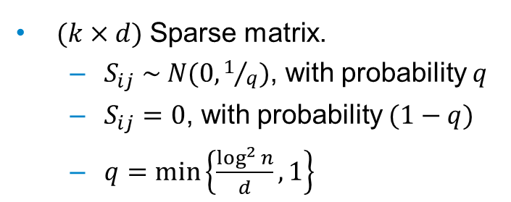
FJLT Method 1
Dimension Reduction for Big Data
25th June 2018
$$Φ=S . H . D$$
$(k×d)$ Sparse matrix.
$S_{ij} \sim N(0,1/q)$, with probability $q$
$S_{ij}=0$, with probability $(1−q)$
$q=\min\left\{\frac{\log^{2}{n}}{d},1\right\}$
Notes:
Dimension reduction matrix
Sparsifies the input vector
But if input vector is too sparse (i.e. only one non-zero element)

Slide 15
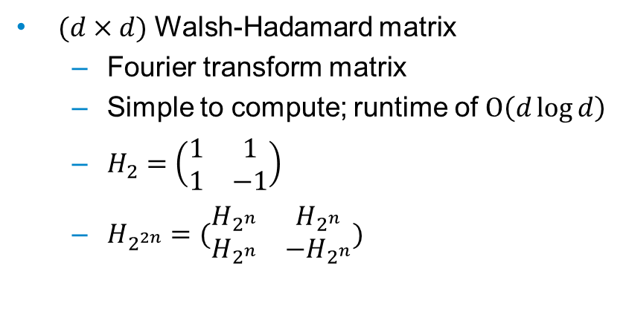
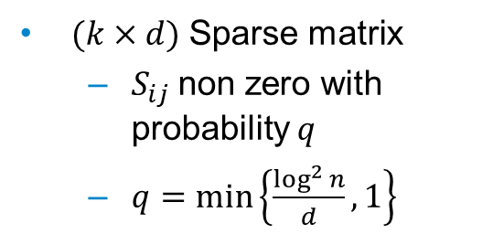
FJLT Method 1
Dimension Reduction for Big Data
25th June 2018
$$Φ=S . H . D$$
$(k×d)$ Sparse matrix
$S_{ij}$non zero with probability $q$
$q=\min\left\{\frac{\log^{2}{n}}{d},1\right\}$
$(d×d)$ Walsh-Hadamard matrix
Fourier transform matrix
Simple to compute; runtime of $Ο\left(d\log{d}\right)$
$H_{2}=\left(\begin{matrix}1 & 1 \\ 1 & −1\end{matrix}\right)$
$H_{2^{2n}}=(\begin{matrix}H_{2^{n}} & H_{2^{n}} \\ H_{2^{n}} & −H_{2^{n}}\end{matrix})$
Notes:
Densifies the input vector i.e any sparse vector

Slide 16
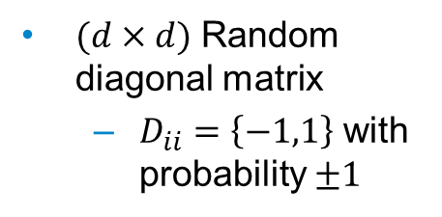
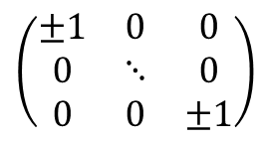
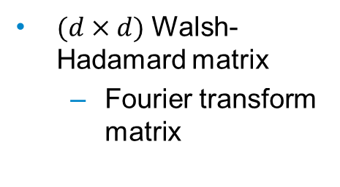
FJLT Method 1
Dimension Reduction for Big Data
25th June 2018
$$Φ=S . H . D$$
$(k×d)$ Sparse matrix
$S_{ij}$non zero with probability $q$
$q=\min\left\{\frac{\log^{2}{n}}{d},1\right\}$
$(d×d)$ Walsh-Hadamard matrix
Fourier transform matrix
$(d×d)$ Random diagonal matrix
$D_{ii}=\left\{−1,1\right\}$ with probability $±1$
$$\left(\begin{matrix}±1 & 0 & 0 \\ 0 & ⋱ & 0 \\ 0 & 0 & ±1\end{matrix}\right)$$
Notes:
To make sure that dense vectors does not become sparse, a random matrix is introduced.

Slide 17
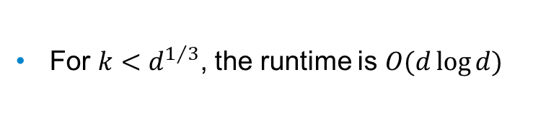
FJLT Method 1
Dimension Reduction for Big Data
25th June 2018
$$Φ=S . H . D$$
$(k×d)$ Sparse matrix
$S_{ij}$non zero with probability $q$
$q=\min\left\{\frac{\log^{2}{n}}{d},1\right\}$
$(d×d)$ Walsh-Hadamard matrix
Fourier transform matrix
$(d×d)$ Random diagonal matrix
$D_{ii}=\left\{−1,1\right\}$ with probability $±1$
For $k<d^{1/3}$, the runtime is $O(d\log{d})$
Notes:
To make sure that dense vectors does not become sparse, a random matrix is introduced.

Slide 18
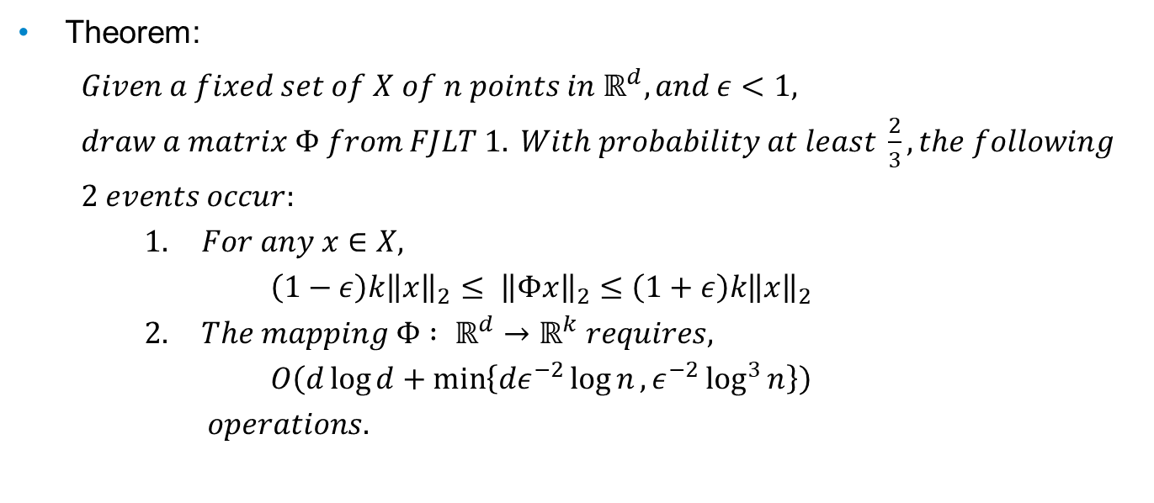
FJLT Method 1
Dimension Reduction for Big Data
25th June 2018
Theorem:
$Given a fixed set of X of n points in ℝ^{d}, and ε<1,$
$draw a matrix Φ from FJLT 1. With probability at least \frac{2}{3}, the following$
$2 events occur:$
$1. For any x∈X,$
$\left(1−ε\right)k{\left\|x\right\|}_{2}≤ {\left\|Φx\right\|}_{2}≤\left(1+ε\right)k{\left\|x\right\|}_{2}$
$2. The mapping Φ : ℝ^{d}→ℝ^{k} requires,$
$O\left(d\log{d+\min\left\{dε^{−2}\log{n},ε^{−2}\log^{3}{n}\right\}}\right)$
$operations.$

Slide 19

Design Methods
Dimension Reduction for Big Data
25th June 2018
FJLT projection method 1
Sparse matrices
Computation time: $O(d\log{d})$
Reduced dimension: $k≤d^{1/3}$
FJLT projection method 2
Methods from coding theory
Notes:
yielding low-complexity solutions to dimension reduction
implement efficient random projectors for dimension reduction

Slide 20

Summary
Dimension Reduction for Big Data
25th June 2018
FJLT projection method 1
Sparse matrices
Computation time: $O(d\log{d})$
Reduced dimension: $k≤d^{1/3}$
FJLT projection method 2
Methods from coding theory
Computation time: $O(d\log{k})$
Reduced dimension: $k<d^{1/2}$
Notes:
yielding low-complexity solutions to dimension reduction
implement efficient random projectors for dimension reduction

Slide 21

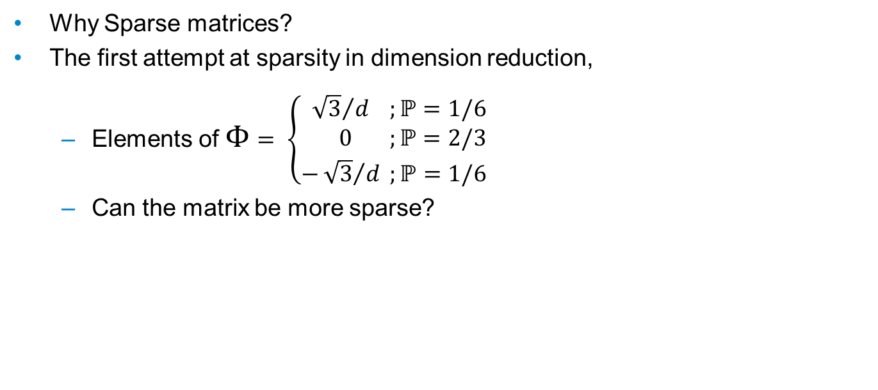

SPARSITY
Dimension Reduction for Big Data
14/12/2017
Why Sparse matrices?
The first attempt at sparsity in dimension reduction,
Elements of $Φ$ $= \left\{\begin{aligned}{ \sqrt{3}}/d ;ℙ=1/6 \\ 0 ;ℙ=2/3 \\ −{\sqrt{3}}/d ;ℙ=1/6\end{aligned} \right.$
Can the matrix be more sparse?
$$\left(\begin{aligned}\begin{matrix}x & 0 & x \\ 0 & x & 0 \\ x & 0 & 0\end{matrix} \begin{matrix}0 & 0 & 0 \\ 0 & x & 0 \\ x & 0 & x\end{matrix} \\ \begin{matrix}0 & 0 & x \\ x & 0 & 0 \\ 0 & x & 0\end{matrix} \begin{matrix}0 & 0 & 0 \\ 0 & 0 & x \\ 0 & x & 0\end{matrix}\end{aligned}\right)$$
$$\left({0 \atop \begin{aligned}0 \\ 0 \\ 1 \\ 0 \\ 0\end{aligned} }\right)$$

Slide 22
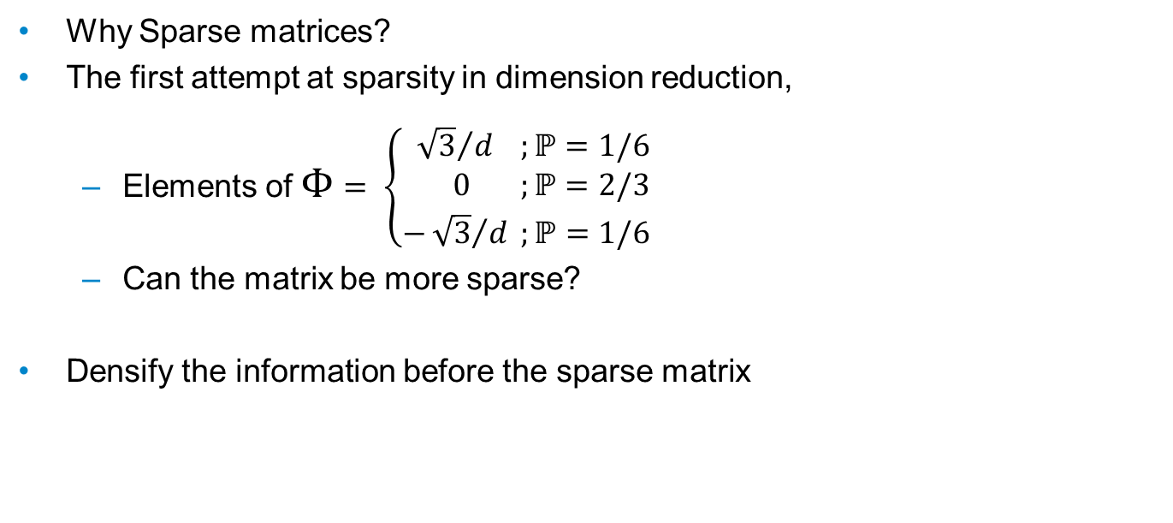
SPARSITY
Dimension Reduction for Big Data
14/12/2017
Why Sparse matrices?
The first attempt at sparsity in dimension reduction,
Elements of $Φ$ $= \left\{\begin{aligned}{ \sqrt{3}}/d ;ℙ=1/6 \\ 0 ;ℙ=2/3 \\ −{\sqrt{3}}/d ;ℙ=1/6\end{aligned} \right.$
Can the matrix be more sparse?
Densify the information before the sparse matrix
$$\left(\begin{aligned}\begin{matrix}x & 0 & x \\ 0 & x & 0 \\ x & 0 & 0\end{matrix} \begin{matrix}0 & 0 & 0 \\ 0 & x & 0 \\ x & 0 & x\end{matrix} \\ \begin{matrix}0 & 0 & x \\ x & 0 & 0 \\ 0 & x & 0\end{matrix} \begin{matrix}0 & 0 & 0 \\ 0 & 0 & x \\ 0 & x & 0\end{matrix}\end{aligned}\right)$$
$$\left({0 \atop \begin{aligned}0 \\ 0 \\ 1 \\ 0 \\ 0\end{aligned} }\right)$$

Slide 23

FAST JL TRANSFORM
Dimension Reduction for Big Data
14/12/2017
$Φ=S . H . D$

Slide 24


FAST JL TRANSFORM
Dimension Reduction for Big Data
14/12/2017
$Φ=S . H . D$
$D_{d×d}$ : Random diagonal matrix with $D_{ii}=\left\{−1,1\right\}$ with probability ½.
$$\left(\begin{matrix}±1 & 0 & 0 \\ 0 & ⋱ & 0 \\ 0 & 0 & ±1\end{matrix}\right)$$

Slide 25
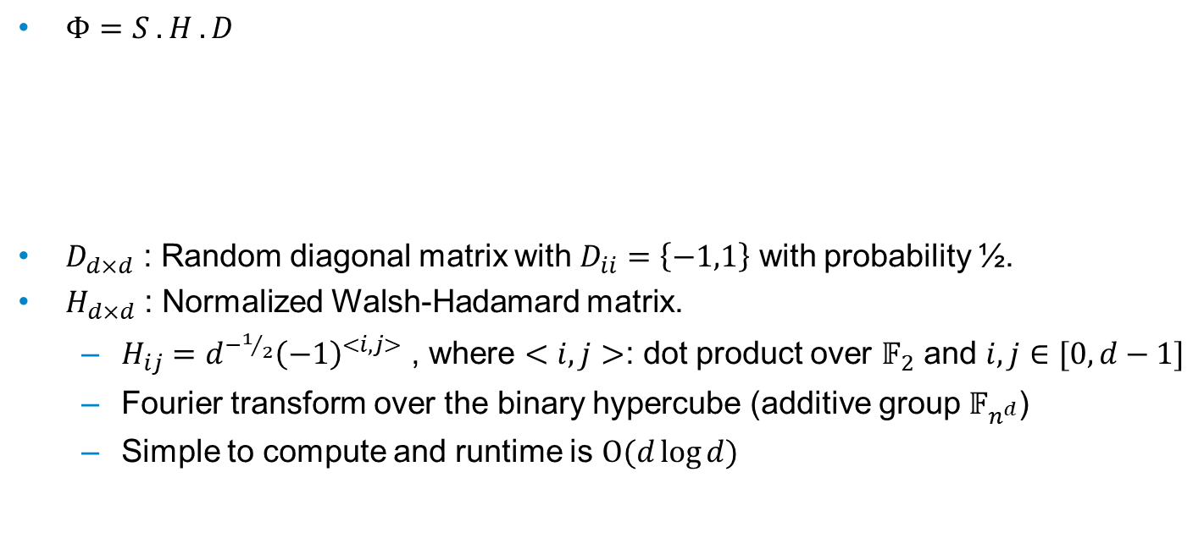
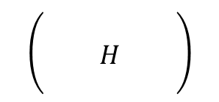
FAST JL TRANSFORM
Dimension Reduction for Big Data
14/12/2017
$Φ=S . H . D$
$D_{d×d}$ : Random diagonal matrix with $D_{ii}=\left\{−1,1\right\}$ with probability ½.
$H_{d×d}$ : Normalized Walsh-Hadamard matrix.
$H_{ij}=d^{−1/2}{\left(−1\right)}^{<i,j>}$ , where $<i,j>$: dot product over $𝔽_{2}$ and $i,j∈[0,d−1]$
Fourier transform over the binary hypercube (additive group $𝔽_{n^{d}}$)
Simple to compute and runtime is $Ο(d\log{d})$
$$\left(\begin{matrix} & & \\ & H & \\ & & \end{matrix}\right)$$
$$\left(\begin{matrix}±1 & 0 & 0 \\ 0 & ⋱ & 0 \\ 0 & 0 & ±1\end{matrix}\right)$$

Slide 26


FAST JL TRANSFORM
Dimension Reduction for Big Data
14/12/2017
$Φ=S . H . D$
$D_{d×d}$ : Random diagonal matrix with $D_{ii}=\left\{−1,1\right\}$ with probability ½.
$H_{d×d}$ : Normalized Walsh-Hadamard matrix.
$S_{k×d}$ : Sparse matrix.
$P_{ij} \sim N(0,1/q)$, with probability $q$ and $P_{ij}=0$, with probability $(1−q)$
$q=\min\left\{Θ\left(\frac{ε^{p−2}\log^{p}{n}}{d}\right),1\right\}$, $p∈\{1,2\}$
Required sparsity $≈$ $k^{3}$ non-zero entries
n: size of the data matrix X, i.e. number of points
$$\left(\begin{matrix} & & \\ & H & \\ & & \end{matrix}\right)$$
$$\left(\begin{matrix}±1 & 0 & 0 \\ 0 & ⋱ & 0 \\ 0 & 0 & ±1\end{matrix}\right)$$
$$\left(\begin{matrix}? & & ? \\ & ? & \end{matrix}\right)$$

Slide 27
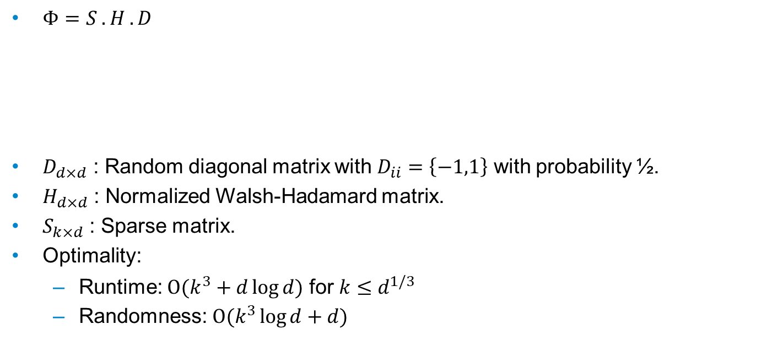
FAST JL TRANSFORM
Dimension Reduction for Big Data
14/12/2017
$Φ=S . H . D$
$D_{d×d}$ : Random diagonal matrix with $D_{ii}=\left\{−1,1\right\}$ with probability ½.
$H_{d×d}$ : Normalized Walsh-Hadamard matrix.
$S_{k×d}$ : Sparse matrix.
Optimality:
Runtime: $Ο(k^{3}+d\log{d})$ for $k≤d^{1/3}$
Randomness: $Ο(k^{3}\log{d}+d)$
$$\left(\begin{matrix} & & \\ & H & \\ & & \end{matrix}\right)$$
$$\left(\begin{matrix}±1 & 0 & 0 \\ 0 & ⋱ & 0 \\ 0 & 0 & ±1\end{matrix}\right)$$
$$\left(\begin{matrix}? & & ? \\ & ? & \end{matrix}\right)$$

Slide 28
INTRODUCTION (2)
Dimension Reduction for Big Data
13/12/2017
Random projection first introduced in 1980’s by Johnson and Lindenstrauss
The Johnson-Lindenstrauss Transform:
For any $\left(x,y\right)∈X$, $\left(1−ε\right){\left\|x−y\right\|}_{2}≤ {\left\|Φ\left(x−y\right)\right\|}_{2}≤\left(1+ε\right){\left\|x−y\right\|}_{2}$
Projecting the points in the data set ($X$) on to a random low dimensional subspace should, up to a distortion of $1±ε$, preserve pairwise distances
Fast JL Transform (FJLT): first attempt of sparsity on JL
Runtime: $Ο\left(\max\left\{d\log{d},k^{3}\right\}\right)$
For $k$ in $[Ω\left(\log{d}\right), Ο(d^{1/2})]$

Slide 29
FJLT with Coding Theory
Dimension Reduction for Big Data
13/12/2017
Welsh-Hadamard matrix
$H_{ij}=d^{−1/2} {\left(−1\right)}^{<i,j>}$ for all $i,j∈[0,d−1]$, where $<i,j>$ is the dot product over $𝔽_{2}$
Encodes the Fourier transform over the binary hypercube
$x ⟼Hx$, for any $x∈l_{2}^{d}$, can be computed in $Ο\left(d\log{d}\right)$ and is isomorphic
Define: $A∈ℝ^{m×d}$ is a code matrix is equal to some row of $H$ times $\sqrt{d/m}$
Equivalent to a dual BCH code of designed distance 3.

Slide 30
MECHANISM (NEW $Φ$)
Dimension Reduction for Big Data
13/12/2017
$Φ=B . D_{1} . H . D_{3} … H . D_{1/γ}$ where $γ$ is an arbitrary small constant
$D_{d×d}$ : Diagonal matrix with $D_{ii}=\left\{−1,1\right\}$ with probability ½.
$B_{k×d}$ : Error correction matrix containing deterministic non-trivial choice of rows of H

Slide 31
MECHANISM (NEW $Φ$)
Dimension Reduction for Big Data
13/12/2017
$Φ=B . D_{1} . H . D_{3} … H . D_{1/γ}$ where $γ$ is an arbitrary small constant
$D_{d×d}$ : Diagonal matrix with $D_{ii}=\left\{−1,1\right\}$ with probability ½.
$B_{k×d}$ : Error correction matrix containing deterministic non-trivial choice of rows of H
Optimality?
Runtime: $Ο(d\log{k})$ ($Ο\left(\max\left\{d\log{d},k^{3}\right\}\right)$for sparse JL)
For $k≤d^{1/2−γ}$ ($d^{1/2}$ for sparse JL)

Slide 32
MECHANISM (NEW $Φ$)
Dimension Reduction for Big Data
13/12/2017
$Φ=B . D_{1} . H . D_{3} … H . D_{1/γ}$ where $γ$ is an arbitrary small constant
$D_{d×d}$ : Diagonal matrix with $D_{ii}=\left\{−1,1\right\}$ with probability ½.
$B_{k×d}$ : Error correction matrix containing deterministic non-trivial choice of rows of H
Optimality?
Runtime: $Ο(d\log{k})$ ($Ο\left(\max\left\{d\log{d},k^{3}\right\}\right)$for sparse JL)
For $k≤d^{1/2−γ}$ ($d^{1/2}$ for sparse JL)
How?
Observing the $l_{4}$-norm, ${\left\|HDx\right\|}_{4}≤ {\left\|x\right\|}_{4}d^{−γ}+d^{−1/4}$, and after $1/γ$ steps, for all $x∈X$, ${\left\|x\right\|}_{4}≤d^{−1/4}$

Slide 33
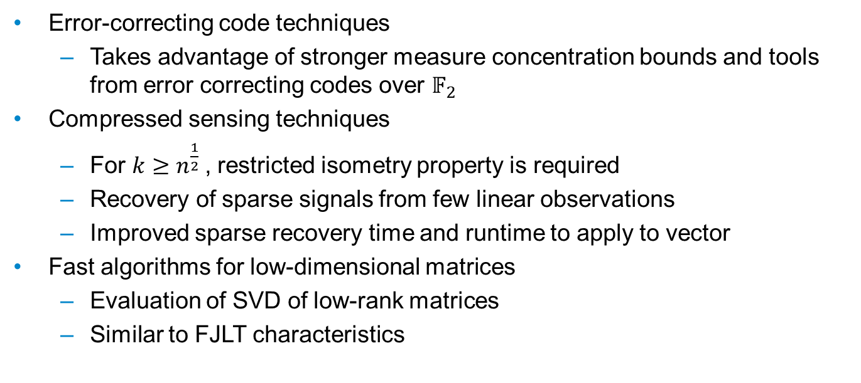
FURTHER RESEARCH
Dimension Reduction for Big Data
14/12/2017
Error-correcting code techniques
Takes advantage of stronger measure concentration bounds and tools from error correcting codes over $𝔽_{2}$
Compressed sensing techniques
For $k≥n^{\frac{1}{2}}$, restricted isometry property is required
Recovery of sparse signals from few linear observations
Improved sparse recovery time and runtime to apply to vector
Fast algorithms for low-dimensional matrices
Evaluation of SVD of low-rank matrices
Similar to FJLT characteristics

Slide 34
THANK YOU
Dimension Reduction for Big Data
14/12/2017

Slide 35
Dimension Reduction for Big Data
14/12/2017

Slide 36
APPENDIX
14/12/2017
Devin Nanayakkara

Slide 37
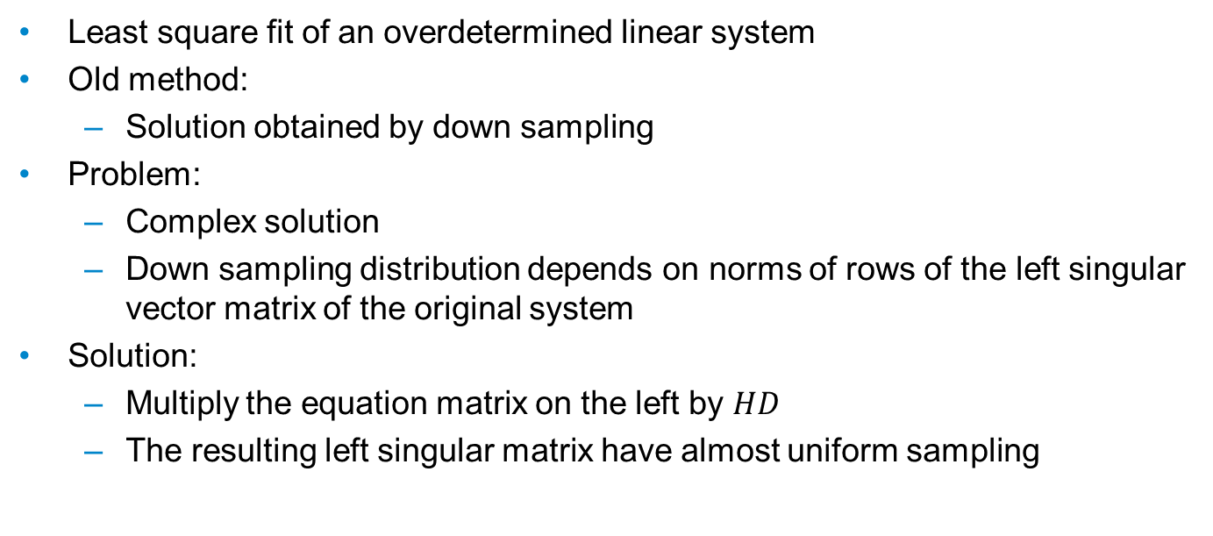
$$ℓ_{2} Regression$$
Appendix
14/12/2017
Least square fit of an overdetermined linear system
Old method:
Solution obtained by down sampling
Problem:
Complex solution
Down sampling distribution depends on norms of rows of the left singular vector matrix of the original system
Solution:
Multiply the equation matrix on the left by $HD$
The resulting left singular matrix have almost uniform sampling

